Slide 1
Azure

Slide 2
Azure Cognitive Services/Applied AI Services
Azure Cognitive Services are cloud-based services that encapsulate AI capabilities. Rather than a single product, you should think of Azure Cognitive Services as a set of individual services that you can use as building blocks to compose sophisticated, intelligent applications.
Cognitive services includes a wide range of individual AI services across multiple categories, as shown in the following table.
Language | Speech | Vision | Decision
Language | Speech | Computer Vision | Anomaly Detector
Translator |  | Custom Vision | Content Moderator
 |  | Face | Personalizer
You can use Cognitive Services to build your own AI solutions, and they also underpin Azure Applied AI Services that provide out-of-the-box solutions for common AI scenarios. Applied AI Services include:
Azure Form Recognizer - an optical character recognition (OCR) solution that can extract semantic meaning from forms, such as invoices, receipts, and others.
Azure Metrics Advisor - A service built on the Anomaly Detector cognitive service that simplifies real-time monitoring and response to critical metrics.
Azure Video Analyzer for Media - A comprehensive video analysts solution build on the Video Indexer cognitive service.
Azure Immersive Reader - A reading solution that supports people of all ages and abilities.
Azure Bot Service - A cloud service for delivering conversational AI solutions, or bots.
Azure Cognitive Search - A cloud-scale search solution that uses cognitive services to extract insights from data and documents.

Slide 3
Machine learning in Microsoft Azure
Microsoft Azure provides the Azure Machine Learning service - a cloud-based platform for creating, managing, and publishing machine learning models. Azure Machine Learning provides the following features and capabilities:
Feature | Capability
Automated machine learning | This feature enables non-experts to quickly create an effective machine learning model from data.
Azure Machine Learning designer | A graphical interface enabling no-code development of machine learning solutions.
Data and compute management | Cloud-based data storage and compute resources that professional data scientists can use to run data experiment code at scale.
Pipelines | Data scientists, software engineers, and IT operations professionals can define pipelines to orchestrate model training, deployment, and management tasks.

Slide 4
Computer vision services in Microsoft Azure
Microsoft Azure provides the following cognitive services to help you create computer vision solutions:
Service | Capabilities
Computer Vision | You can use this service to analyze images and video, and extract descriptions, tags, objects, and text.
Custom Vision | Use this service to train custom image classification and object detection models using your own images.
Face | The Face service enables you to build face detection and facial recognition solutions.
Form Recognizer | Use this service to extract information from scanned forms and invoices.

Slide 5
NLP in Microsoft Azure
In Microsoft Azure, you can use the following cognitive services to build natural language processing solutions:
Service | Capabilities
Language | Use this service to access features for understanding and analyzing text, training language models that can understand spoken or text-based commands and building intelligent applications.
Translator | Use this service to translate text between more than 60 languages.
Speech | Use this service to recognize and synthesize speech, and to translate spoken languages.
Azure Bot | This service provides a platform for conversational AI, the capability of a software "agent" to participate in a conversation. Developers can use the Bot Framework to create a bot and manage it with Azure Bot Service - integrating back-end services like Language, and connecting to channels for web chat, email, Microsoft Teams, and others.

Slide 6
Knowledge mining in Microsoft Azure
Knowledge mining is the term used to describe solutions that involve extracting information from large volumes of often unstructured data to create a searchable knowledge store.
One of these knowledge mining solutions is Azure Cognitive Search, a private, enterprise, search solution that has tools for building indexes. The indexes can then be used for internal only use, or to enable searchable content on public facing internet assets.
Azure Cognitive Search can utilize the built-in AI capabilities of Azure Cognitive Services such as image processing, content extraction, and natural language processing to perform knowledge mining of documents. The product's AI capabilities makes it possible to index previously unsearchable documents and to extract and surface insights from large amounts of data quickly.

Slide 7
Options for Azure resources
Multi-service resource
You can provision a Cognitive Services resource that supports multiple different cognitive services. For example, you could create a single resource that enables you to use the Language, Computer Vision, Speech, and other services.
Single-service resource*
Each cognitive service can be provisioned individually, for example by creating discrete Language and Computer Vision resources in your Azure subscription.
*Single-service resources generally offer a free tier (with usage restrictions), making them a good choice to try out a service before using it in a production application.

Slide 8
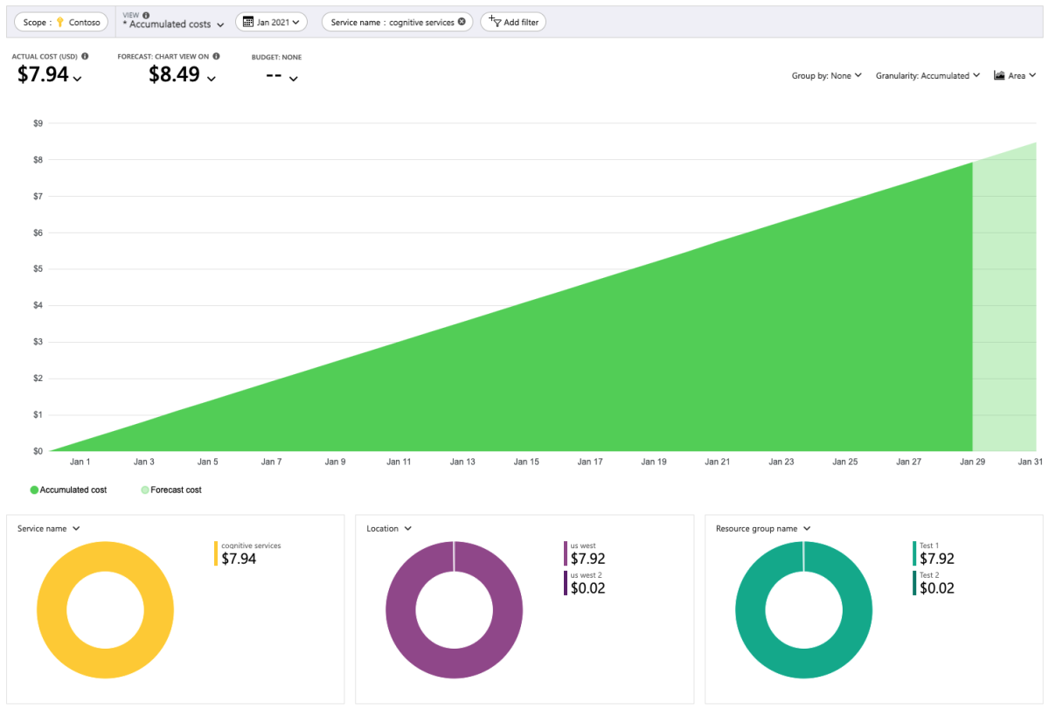
Plan Costs

Slide 9
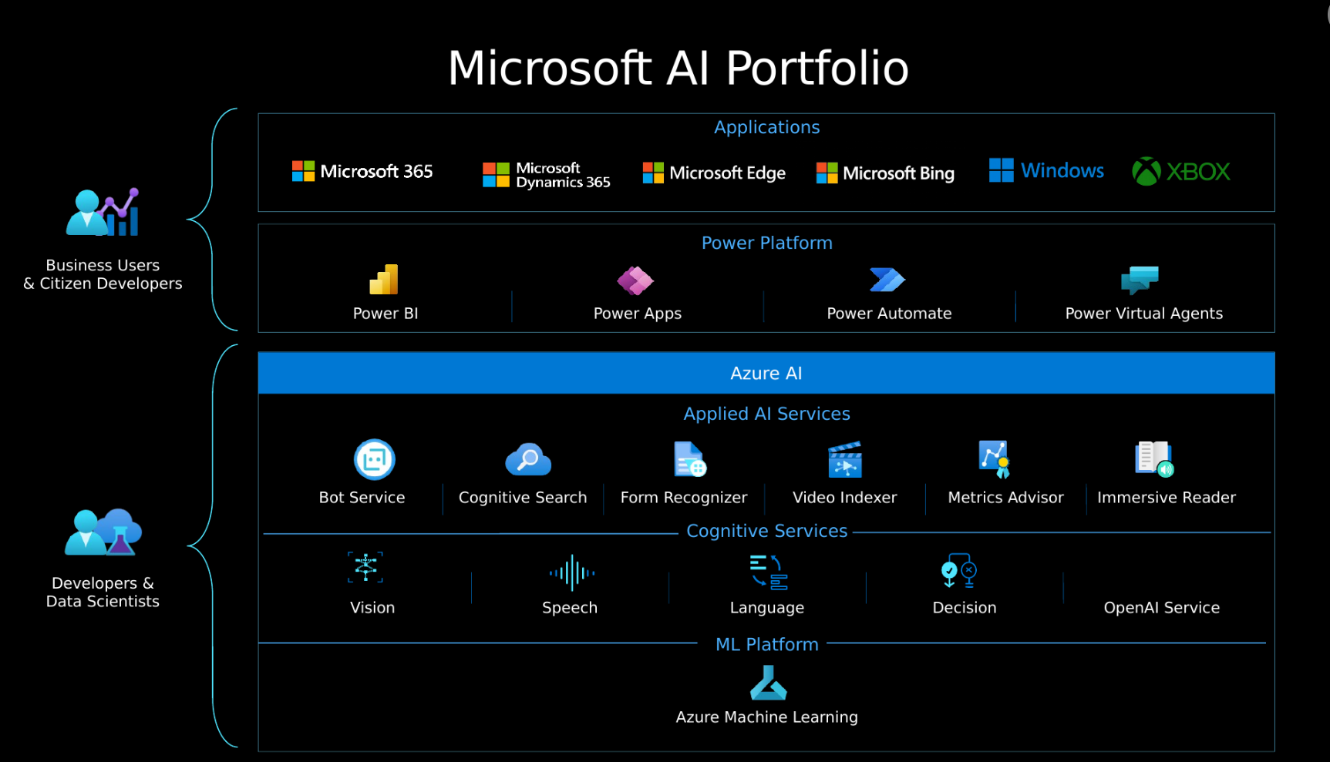
Azure OpenAI's relationship to Azure AI services
These Azure OpenAI models include:
GPT-4 models that represent the latest generative models for natural language and code.
GPT-3.5 models that can generate natural language and code responses based on prompts.
Embeddings models that convert text to numeric vectors for analysis - for example comparing sources of text for similarity.
DALL-E models that generate images based on natural language descriptions.

Slide 10
Azure OAI Pricing
Models | Context | Prompt (Per 1,000 tokens) | Completion (Per 1,000 tokens)
ChatGPT | 4K | $0.002 | $0.0015
ChatGPT | 16K | $0.003 | $0.004
GPT4 | 8K | $0.03 | $0.06
GPT4 | 32K | $0.06 | $0.12
Models | Per 100 images
 | Standard
Dall-E | $2
Models | Per 1,000 tokens
 | Standard
Ada | $0.0001

Slide 11
Usecases
Task | Prompt
Summarizing text | "Summarize this text into a short blurb"
Classifying text | "What genre of book is this?"
Generating names or phrases | "Write a tagline for my flower company"
Translation | "Translate 'How are you' to French"
Answering questions | "What does Azure OpenAI do?"
Suggesting content | "Give me the five best weddings songs"

Slide 12
Responsible AI
Fairness: AI systems shouldn't make decisions that discriminate against or support bias of a group or individual.
Reliability and Safety: AI systems should respond safely to new situations and potential manipulation.
Privacy and Security: AI systems should be secure and respect data privacy.
Inclusiveness: AI systems should empower everyone and engage people.
Accountability: People must be accountable for how AI systems operate.
Transparency: AI systems should have explanations so users can understand how they're built and used.

Slide 13
Language Understanding Model
Utterances are the phrases that a user might enter when interacting with an application that uses your Language Understanding model. An intent represents a task or action the user wants to perform, or more simply the meaning of an utterance. You create a model by defining intents and associating them with one or more utterances.
Entities are used to add specific context to intents. For example, you might define a TurnOnDevice intent that can be applied to multiple devices, and use entities to define the different devices.
Utterance | Intent | Entities
What is the time? | GetTime
What time is it in London? | GetTime | Location (London)
What's the weather forecast for Paris? | GetWeather | Location (Paris)
Will I need an umbrella tonight? | GetWeather | Time (tonight)
What's the forecast for Seattle tomorrow? | GetWeather | Location (Seattle), Time (tomorrow)
Turn the light on. | TurnOnDevice | Device (light)
Switch on the fan. | TurnOnDevice | Device (fan)

Slide 14
Azure AI Language
Extract information
Use Natural Language Understanding (NLU) to extract information from unstructured text. For example, identify key phrases or Personally Identifiable Information (PII), summarize text, recognize and categorize named entities, or customize an entity extraction model on top of your domain set.
Extract key phrases
Find linked entities
Named Entity Recognition (NER)
Personally Identifiable Information (PII) detection
Custom Named Entity Recognition (custom NER)
Text analytics for health
Custom text analytics for health
Summarize text-based content
Summarize lengthy documents and conversation transcripts.
Document summarization
Conversation summarization
Classify Text
Use Natural Language Understanding (NLU) to detect the language or classify the sentiment of text you have. You can also classify your text documents by customizing a classification model over your dataset.
Analyze sentiment and mine text for opinions
Detect Language
Custom text classification
Answer questions
Provide answers to questions being asked in unstructured texts using our prebuilt capabilities, or customize your domain specific question-and-answer pairs over data you provide.
Question answering
Understand conversations
Create your own models to classify conversational utterances and extract detailed information from them to fulfill scenarios.
Conversational language understanding
Orchestration workflow
Translate text
Use cloud-based neural machine translation to build intelligent, multi-language solutions for your applications.
Use machine translation on text.

Slide 15
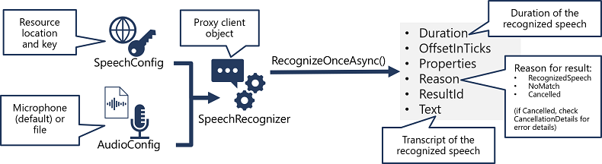
Azure AI Speech

Slide 16
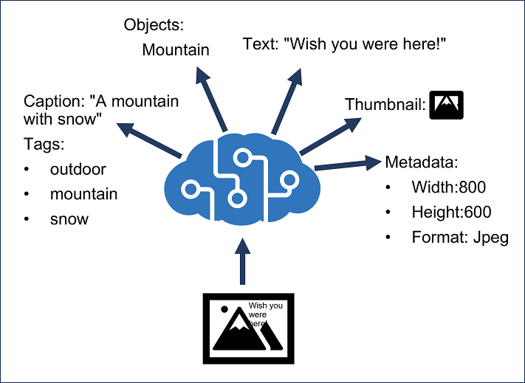
Azure AI Vision
Optical character recognition:
Extract text from images: Extract printed and handwritten text from images and documents
Spatial analysis:
Video summary and frame locator: Generate a summary of the main points shown in a video, locate specific keywords, and jump to the relevant section of the video
Count people in an area: Analyze real-time video to count the number of people in a designated zone
Detect when people cross a line: Analyze real-time streaming video to detect when a person crosses a line
Detect when people enter/exit a zone: Analyze real-time streaming video to detect when a person enters or exits an area
Monitor social distancing: Analyze real-time streaming video to determine if people violate a distance rule
Image analysis:
Search photos with natural language: Retrieve specific moments within a photo album based on vectorized text and image queries
Add captions to images: Generate human-readable English sentences that describe the content of an image
Dense captioning: Generate human-readable English phrases for all important objects within an image
Detect common objects in images: Recognize objects of interested in an image and record their location using bounding boxes
Extract common tags from images: Automatically assign one or more labels to an image based on its content
Detect sensitive content in images: Moderate usage of images by detecting sensitive content

Slide 17
Azure AI Custom Model
Model training
The primary components of the model customization capabilities in Image Analysis 4.0 are the training images, a COCO file, a dataset object, and a model object.
Training images
The collection of training images should include multiple examples for each label you're attempting to detect. You also want to set aside a few extra photos for testing your model once it has been trained. Training images must be stored in an Azure Storage Account container to be accessible to the model. To effectively train your model, you should use images with a visual variety. Select images that vary by camera angle, lighting, background, size, type, and other features that provide the model with enough mixture to recognize image content under different conditions.
Microsoft's Florence models provide excellent few-shot capabilities, achieving remarkable model performance with limited training images. However, providing more training data allows trained models to perform better generally.
COCO files
When training custom models, the Common Object in Context (COCO) file format is used for storing information about training images and their associated annotations, such as the labeling information associated with each training image. In Image Analysis 4.0, the data-labeling workflow in Azure Machine Learning generates the COCO file for your training data. Azure Machine Learning allows you to manually label your images and generate a COCO file that can be imported into Vision Studio.
COCO files are JSON files that provide a standard format for indexing and organizing references to all training images, their associated labeling information, and, for object detection, the specified bounding box coordinates of each tag associated with the training images. COCO files must contain the images, annotations, and categories required fields and should be stored in the same Azure Storage container as the associated training images.
Dataset object
The Dataset object is a data structure stored by the Image Analysis service that references the association file. You must create a Dataset object before creating and training a model.
Model object
The Model object is a data structure stored by the Image Analysis service representing a custom model. It must be associated with a Dataset to perform initial training. Once trained, you can query your model by entering its name in the model-version query parameter of the Analyze Image API call.

